Slide 1
PEER - Participation and Empowerment Experiences with Roma young people
WS4 - Briefing
Barcelona Project Meeting
Nov 29-Dec 1st 2015

Slide 2
Putting WS4 into context
Year 1:
» Developed training manual
» Delivered training to advocates / youth leaders etc. (training trainers)
» Advocates working with young Roma (Trainees) to build capacity (3 groups x 6 mtgs)
» Young Roma undertake initial participation projects
- Identify issues of concern/evaluate participation locally/identify current challenges to participation
» Ongoing evaluation and learning (about what works with participation & with training)
Year 2:
... Further action inquiry...-> WS4, + WS2 & WS3

Slide 3
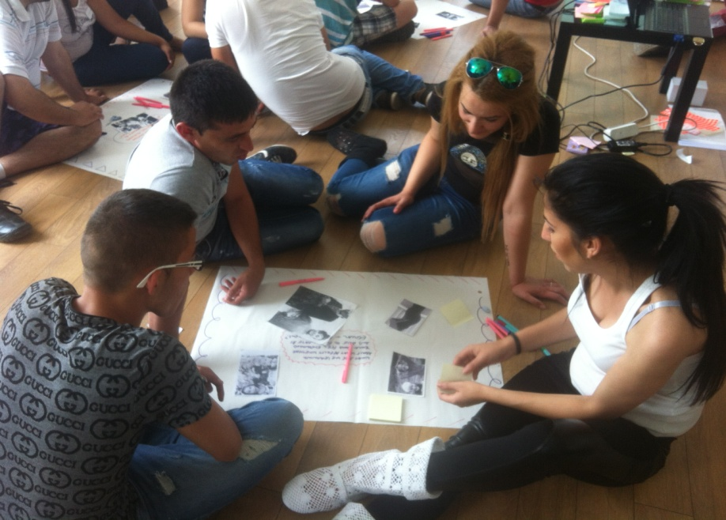
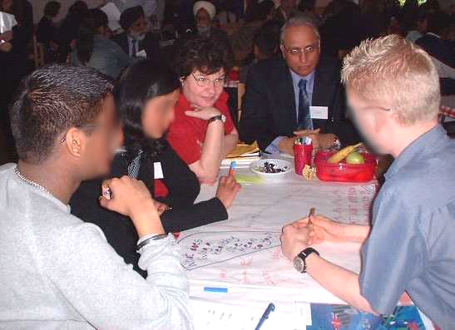
What is WS4 about?
Embedding action learning and change ->
WS4 is about taking steps to consolidate and sustain participation ... by: ...?
Building on learning so far to inform further action inquiry:
- How can we enhance the participation and empowerment of young Roma?
Involving: ...
Developing a deeper understanding of the challenges
and how to overcome these
Improve practices affecting participation and inclusion of young Roma
Continue building capacity amongst young Roma
... also in local systems (local governance, schools, community)
Using learning to develop local systems and practices to enable (and embed) Roma participation
NB: Not just identifying issues but working with young people to explore how to enhance their participation

Slide 4
What does ‘embedding’ participation mean?
Permanent feature rather than one off project
Establishing opportunities, systems and structures
Effective practices (ways of working – how young people are involved)
What types of participation? – having a say or joint learning and decision-making
(Consultation, Collaboration, Child-led)
Culture and values (attitudes to participation as well as to Roma)
Monitoring and evaluating - ongoing learning and change (people & systems)

Slide 5
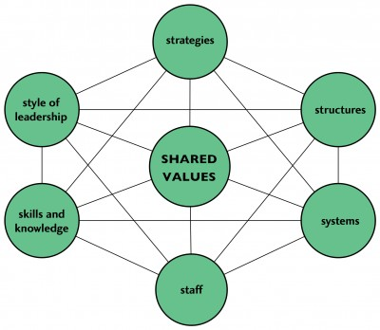
‘Hear by Right’ model – provides a useful framework for organisational participation standards
(www.nya.org.uk/quality/hear-by-right/)
Participation needs to
involve everybody not just
one advocate
But .. is important to have
Participation Champions:
In practice
in policy
Notes:
For organisations to develop cultures of participation they need to change some of the ways they work – eg: structures systems, staff need to have the right skills and knowledge etc.
This model (NYA) based on the 7 s model of organisational standards.
Provides a useful framework of standards against which to monitor organisational change
Key to developing a culture of participation .. but key to all these standards is a culture of shared values about participation

Slide 6
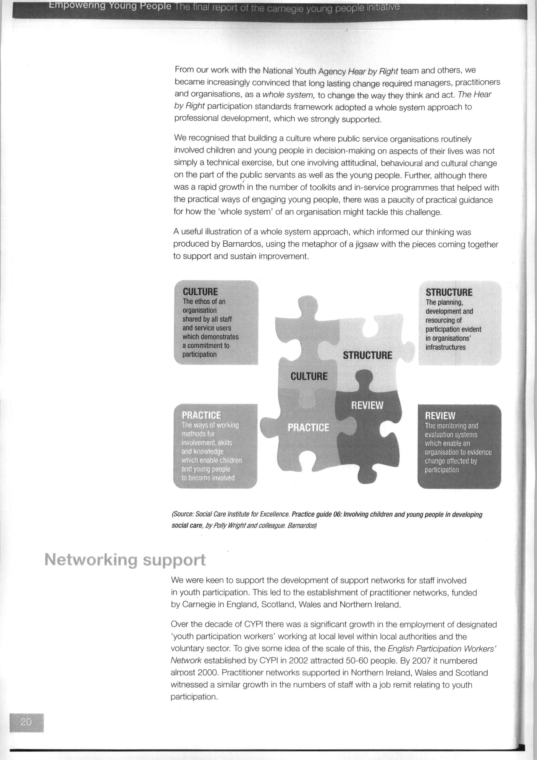
Barnardo’s whole system model

Slide 7
WS4 - Aims and objectives
To extend and support action inquiry with 3 groups of young Roma
Deepen understanding of issues affecting young Roma participation and empowerment and strategies for responding to these
To explore what changes might be possible to enhance the participation and empowerment of young Roma
Achieve real time changes for supporting Roma participation??
Learn from experience to inform development of participatory practice guide

Slide 8
What might the process look like?
Example:
Meet with young Roma, reflect on participation experiences/inquiry into issues and decide on one issue to pursue further
Issue might be about young Roma interests not represented in local municipality
Young Roma spend some sessions exploring together what is stopping their participation, then thinking about how to change that .. What needs to happen (e.g. systems/practices) to support their participation.
Meeting(s)/dialogue with professionals – to communicate their concerns and issues and talk together about what changes are possible
Follow up meetings with local officials (supported by workers) to work together to develop modes of participation (including further capacity building eg. training professionals)
Establish a forum(?) – may meet once or twice
Young Roma reflect on how successful that was. ...draw out learning
NB: Importance of recording ongoing evaluation/learning

Slide 9
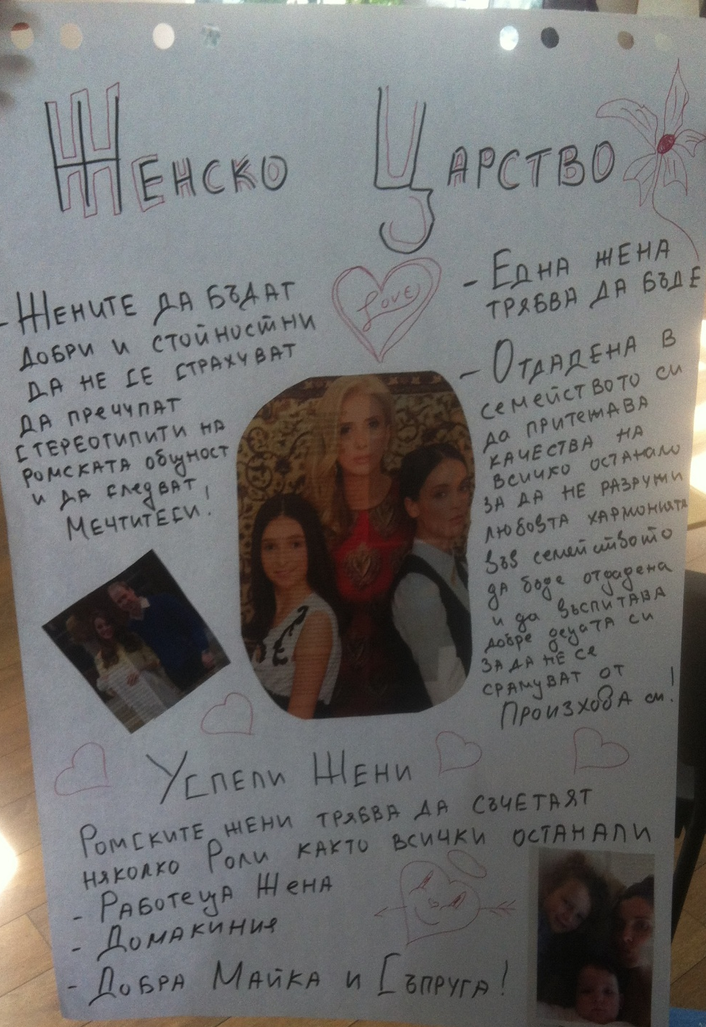
But ... participation not just about having a say ... is also about young Roma having more influence over matters that affect their lives .. (heightened sense of agency) ... responding to their own marginalisation e.g. Roma girls taking control over their lives.
> implications for challenging norms and customs: dialogue with adult community members??
> support for continuing in education beyond primary level.
> campaign to challenge prejudice
Need to be realistic within time available!!

Slide 10
What we have to do?
Work with 3 Roma young people’s groups in each country
Each group meets 12 times (keep record of meetings, attendance forms, activities, learning etc)
Evaluate participants experiences -> evaluation report
- experiences/perspectives of young Roma about what helps/hinders participation
- evidence of impact/stories of change (where possible)
Ongoing sharing on web platform
Guidance on supporting young Roma participation for Participatory practice guide – each group to contribute key aspects

Slide 11
How does this fit with where you are in your work now with young Roma?
Discussion in country teams – thinking through your plans for WS4 (20 mins)
> Issues and questions arising?

Slide 12
Deliverables and timetable
COUNTRY TEAMS WHOLE PROJECT
Protocols of new AR activities????
Work with 3 groups (M13-22)
Evaluation reports (M 22??) Combined Evaluation Report (M24)
Attendance forms (ongoing)
Sharing on web platform (ongoing)
[Multi media data on barriers
& successes]
Learning : participatory practice Participatory practice guide
with young Roma (M21) (M24)

Slide 13
Further questions or queries?

Slide 14
Good luck
  Have fun
        Take risks
            Learn from the experience

