Slide 1


Where are we? What we did?
Universitat Autònoma de Barcelona
Spain

Slide 2
PEER Process in 3 sites - Barcelona
Jan 2015
Meeting w/ NGOs
WS1-A3
Kick off meeting
coordination meetings w/NGOs
Work on Training Manual
Introductory Core Training: May
Comparative Evaluation + Transition...
2016?
Delivering training
of the trainers Sept
Magic 6
In 3 sites
Notes:
WS0 - ACTIVITY 3: UAB team has been constituted and roles corresponding to each member have been clarified. Tasks and responsibilities have been established.

Slide 3
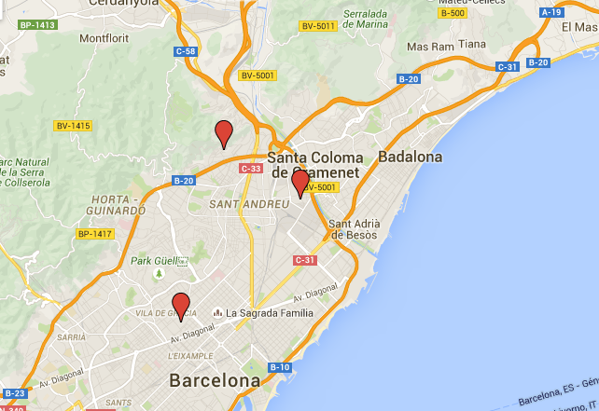
PEER in Barcelona City
Roquetes
Bon Pastor
Gràcia
PEER meeting

Slide 4
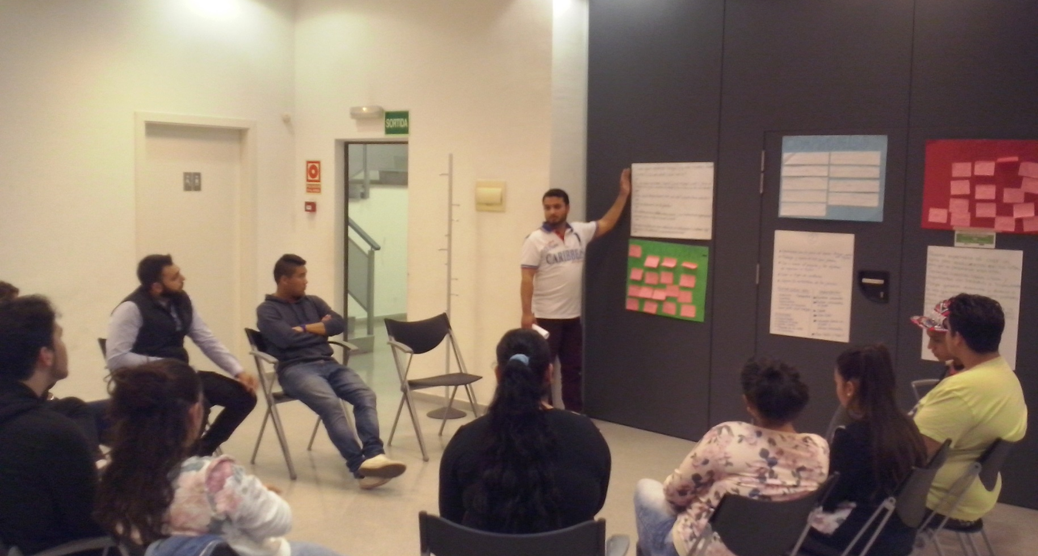
PEER in site  Bon Pastor
Roma Grassroots NGO
Roma coordinator
Roma facilitators
11 youth (15 – 24 yrs)
6 male / 5 female
2 non-Roma included
6 sessions, low “truancy” rate
Goal: Free time club for children
Strong commitment
Support from publ. admin:
Local “youth energizer agent”
In a phase of “self-government”

Slide 5
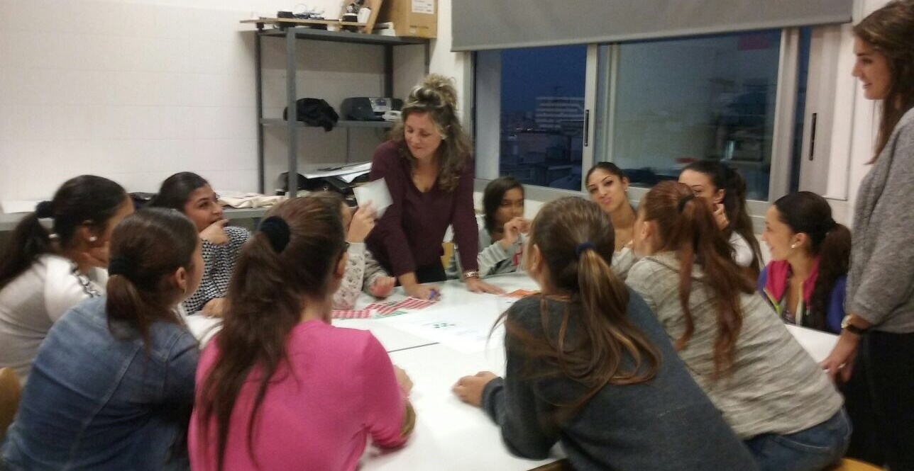
PEER in site  Roquetes
Roma Grassroots NGO
Roma coordinator
Roma facilitators
10 youth (15 – 20 yrs)
Girls only
6 sessions
Goal: Face painting + makeup
Increasing commitment
Weak group cohesion, mid-level truancy
Local stakeholders’ interest & commitment
District councillor for Youth
Social services (citizenship participation agents)

Slide 6
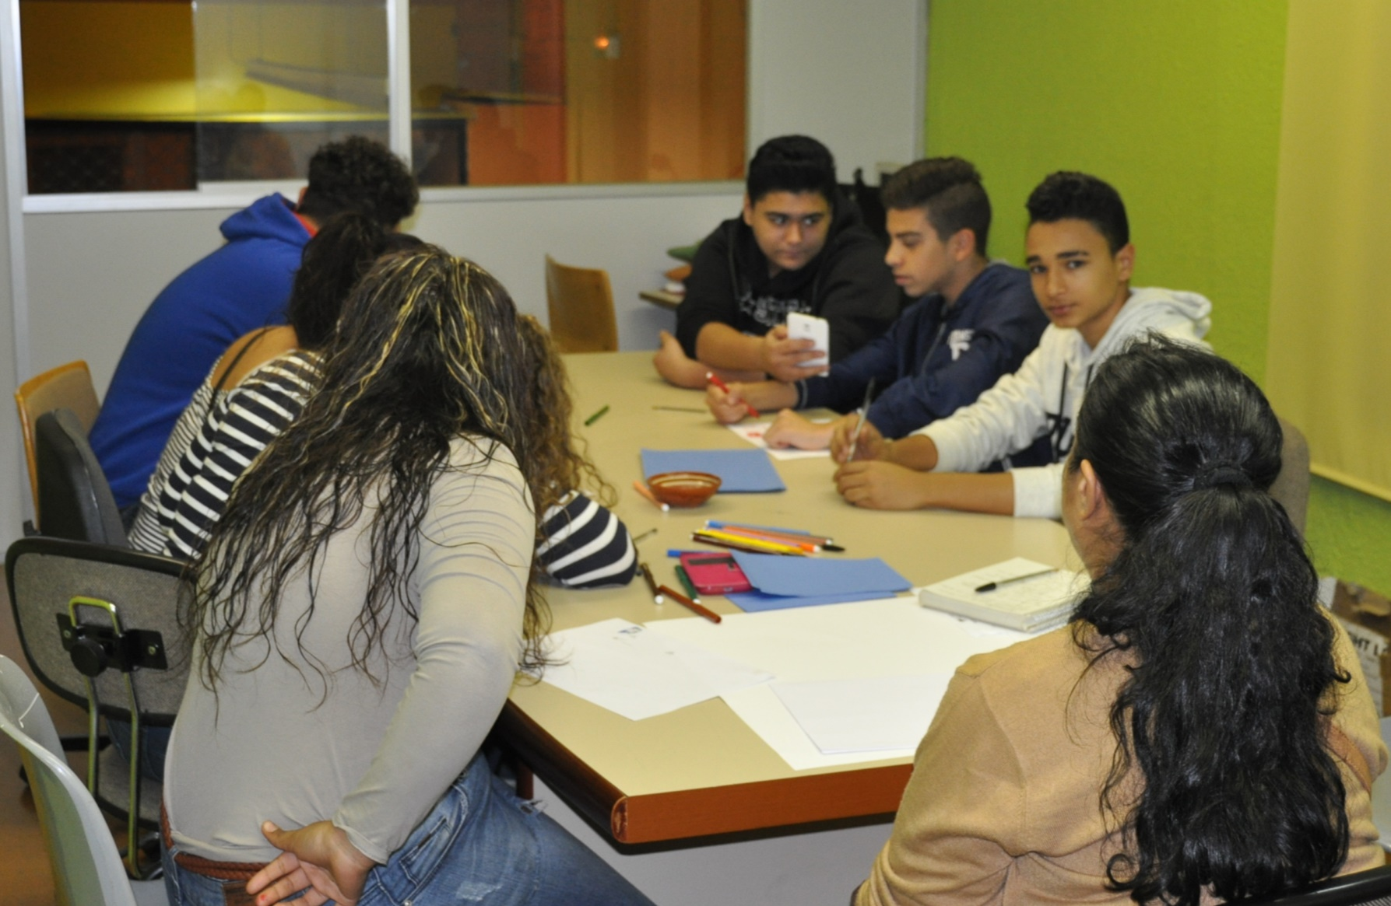
PEER in site  Gràcia
Roma Grassroots NGO
Roma coordinator
Roma facilitators
8 youth (12 – 14 yrs)
Roma only, Mixed
3 sessions
Goal: Roma participation in Festa major (District Festival)
Challenging dynamics!!!
Local stakeholders’ interest & commitment
Citizenship participation agents

Slide 7
BCN PEER Ethical concerns
Imposed, top-down goal definition
Not all families’ informed agreement forms could be collected
In one particular case, participation of children is not clearly voluntary (community pressure)
Project may generate frustrated aspirations

Slide 8
Achievements & Challenges
Constant groups w/ potential continuity
Emerging commitment
Clear, realistic, easy to follow goals
Interest & commitment of local stakeholders
Imposed, top-down goals
Less well-trained facilitators in participative methodology
“vulnerable” age-group (commitments, marriage, labour-market…)
High (false?) expectations
Limited advocacy/lobbying activity
Low visibility

Slide 9
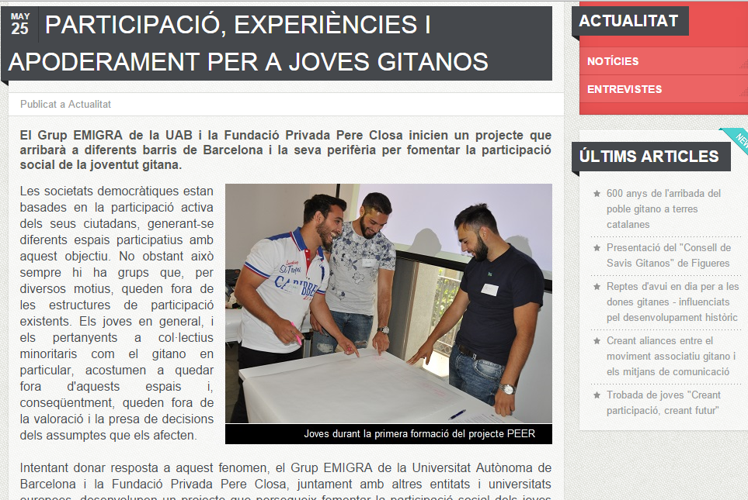

Slide 10
PEER Process in terms of activities & deliverables
WS0
ACTIVITY 3: UAB team has been constituted and roles corresponding to each member have been clarified. Tasks and responsibilities have been established
ACTIVITY 7: One national coordination meeting was held on the 5th of May, 2015, and several other ad-hoc meetings were organised among university researchers, and the three local coordinators (or on bilateral basis)
ACTIVITY 4: The intercountry managerial meeting has been successfully organised, on the 30/11/2015 – 01/12/2015, in Barcelona (Spain)
Notes:
WS0 - ACTIVITY 3: UAB team has been constituted and roles corresponding to each member have been clarified. Tasks and responsibilities have been established.

Slide 11
PEER Process in terms of activities & deliverables
WS1
ACTIVITY 1 [M2]: Content analysis. Gather knowledge on Roma participation experience. collects the information gathered throughout this activity. WS2-ET2A-Tool - Goals & Expectations [Post-Training meeting in May] deliv. done
ACTIVITY 2 [M3 – M7]: Initial manual training meeting. Our input: evaluation tools. deliv. done
ACTIVITY 3 [M7]: Skill and knowledge-building training. [ET2B + ET3D helps evaluate] deliv. done
ACTIVITY 4 [M8 – M9]: 1x 8 hours x15 participants. Most facilitators participated in A3 as well. 18/09/2015 deliv. pending
ACTIVITY 5 [M10-M12 ] Training the trainees MAGIC 6 deliv. pending
Notes:
WS0 - ACTIVITY 3: UAB team has been constituted and roles corresponding to each member have been clarified. Tasks and responsibilities have been established.

Slide 12
PEER Process in terms of activities & deliverables
WS2
ACTIVITY 1. [M4-M6] Development of the evaluation framework and tools. deliv. done
ACTIVITY 2. [M10-M12] Group work with Roma young people to identify their issues deliv. done
ACTIVITY 3. [M13] Evaluation of the group work, to assess successes, challenges deliv pending
Notes:
WS0 - ACTIVITY 3: UAB team has been constituted and roles corresponding to each member have been clarified. Tasks and responsibilities have been established.

