Slide 1


Participation Experience and Empowerment of Roma Youth
Know-how Centre, New Bulgarian University

Slide 2
Main achievements so far:
Expand network
- First coordination event – 25 people from 9 organizations working with Roma – from most marginalized children in mountain villages to Roma university students pursuing career
- worked in groups on the understanding of the concept of participation (barriers and supportive factors)
- shared good practices
- Second event – training of young facilitators
Third event – unforeseen in the initial project plan but needed by the people who work with groups – training part II
Build capacity
Establish teams
Improve knowledge and understanding
Notes:
Self discrimination (by parents, by children)

Slide 3
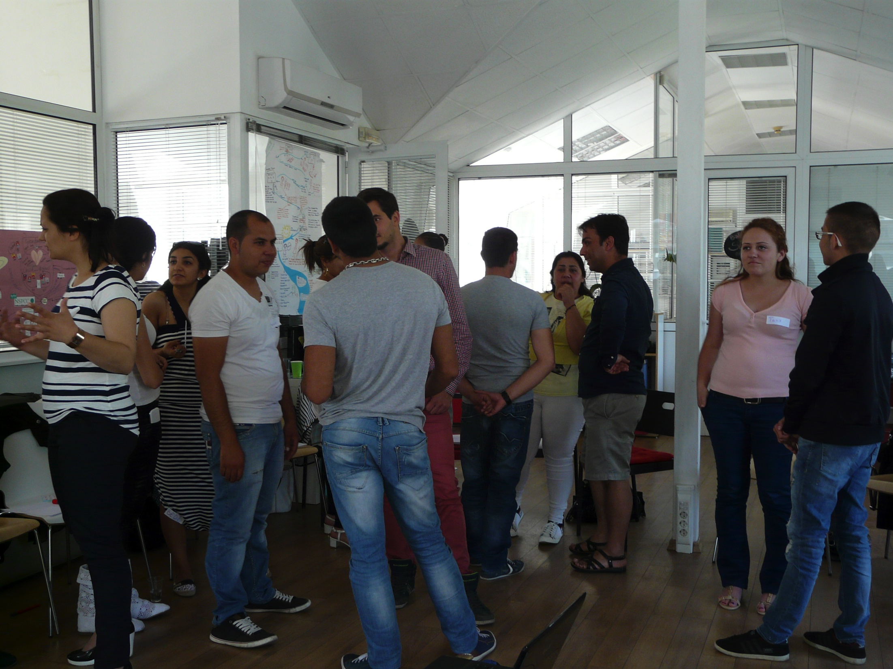

Slide 4
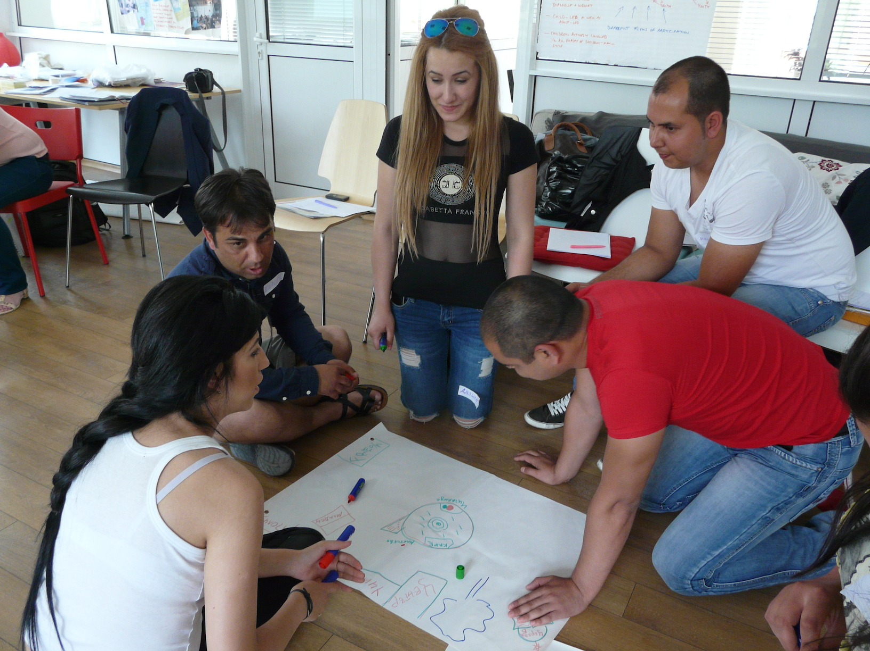
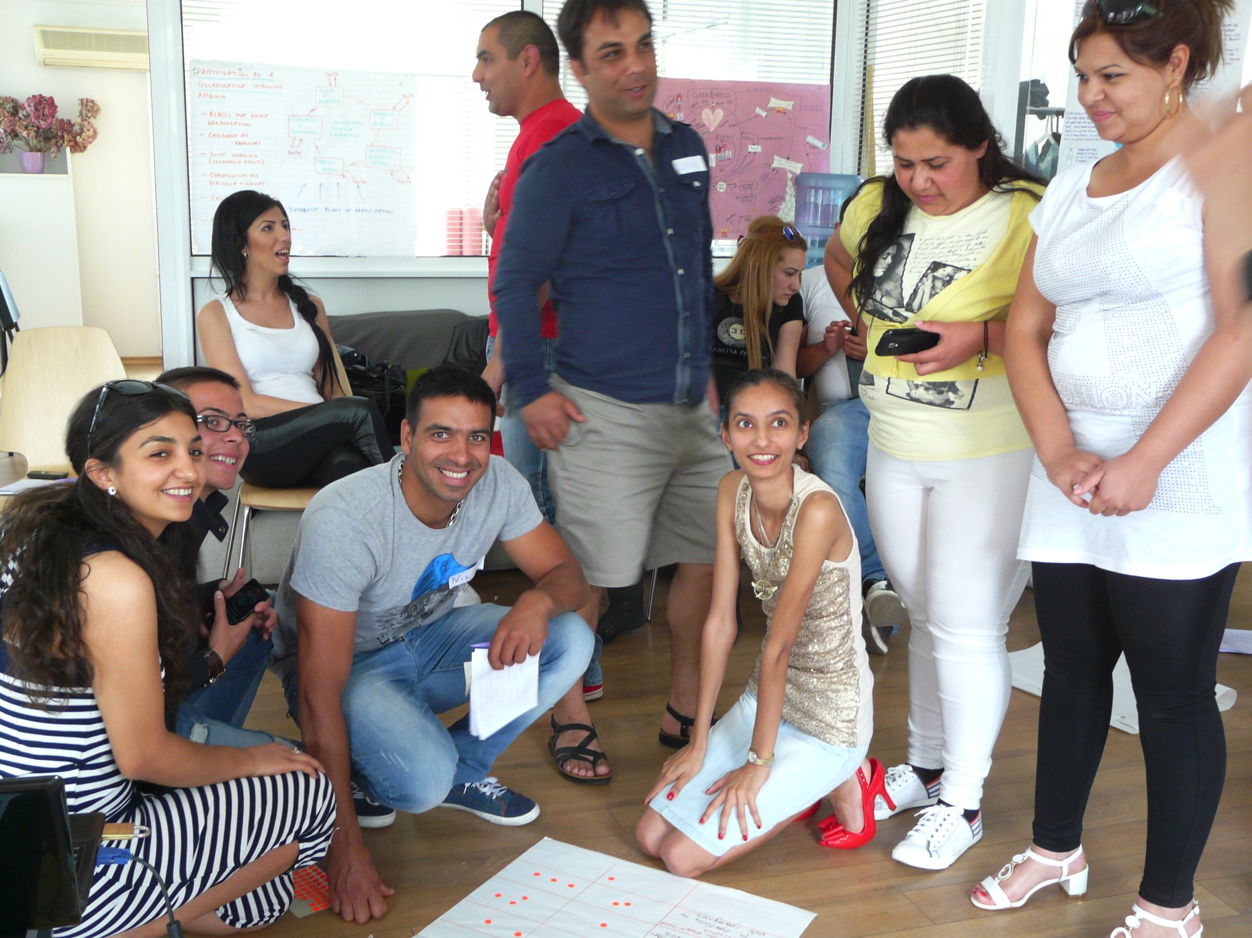

Slide 5
Additional NGO partners in Bulgaria, very committed to the project, especially in the WS2 activities:
Ethno-integration Foundation
Youth organization “Re-Act”
Knowledge Success Change Foundation
Health and Social Development Foundation (HESED)
Associated partners collaborate and contribute also:
Co-Participation Foundation
Youth organization “Hope for Us”
Youth organization “ARETE”

Slide 6
Magic 6 - Our 4 groups
First group in Varna, the third biggest city in Bulgaria with a small Roma community (about 1% of the population according to official data), with a strong economic inequality, where the Roma community lives in the most impoverished suburb in the city. Our partner NGO there, "Co-Participation" does a lot of mobile work on HIV/TB and drug prevention and health education.
Second group in Dupnica - at the facilitator training in June we trained 4 representatives of 2 women organizations, one of them working exclusively with Roma women and girls. Both organizations expressed their willingness to work with a group for Roma teenage girls, so now the team of facilitators in Dupnitsa consists of one representative of each of the 2 organizations - Ethnointegration Foundation and Knowledge Success Change Foundation. Dupnica is a town characterized with good social services and relatively good level of industry and employment, but still lots of emigration of young people. The Roma community is about 10% of the population, with not such a drastic inequality like in Varna but still with many social problems, including low level of participation.

Slide 7
Third group in Sopot - it is a mixed group in the context of the local high-school where half of the children are Roma. Sopot is a small town in a poor region of Bulgaria. The total number of population is about 9000 people. The group is led by a facilitator, representative of the New Bulgarian University and a representative of the Health and Social Development Foundation (HESED).
Fourth group in Rakitovo, again with small population, less than 9000 but with a large Roma community. We have a group of young Roma people there, some of them living in the community with their families, and some of them living in a closed institution, isolated from the society due to poverty, legal offenses or other reason. These institutions for young offenders are a legacy from the totalitarian times and are usually isolated from the society, with lack of services and programs for the young people, almost 100% of the young people living there are Roma and large percent of them are illiterate. The team of facilitators is from the youth organization "Re-Act".

Slide 8
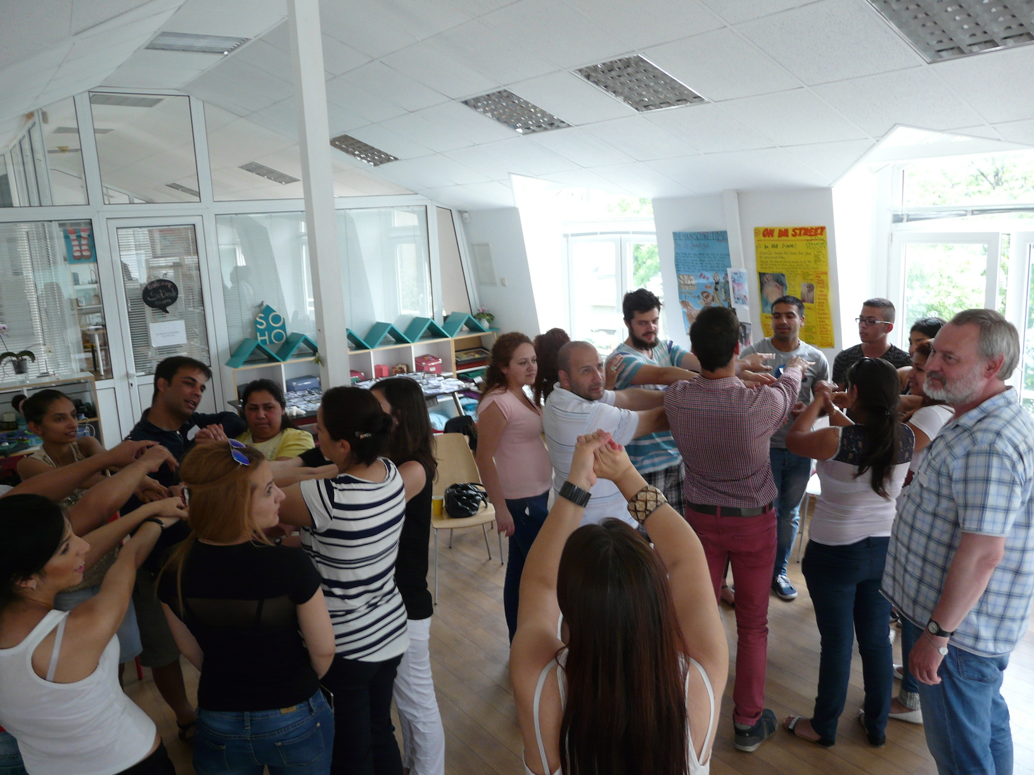
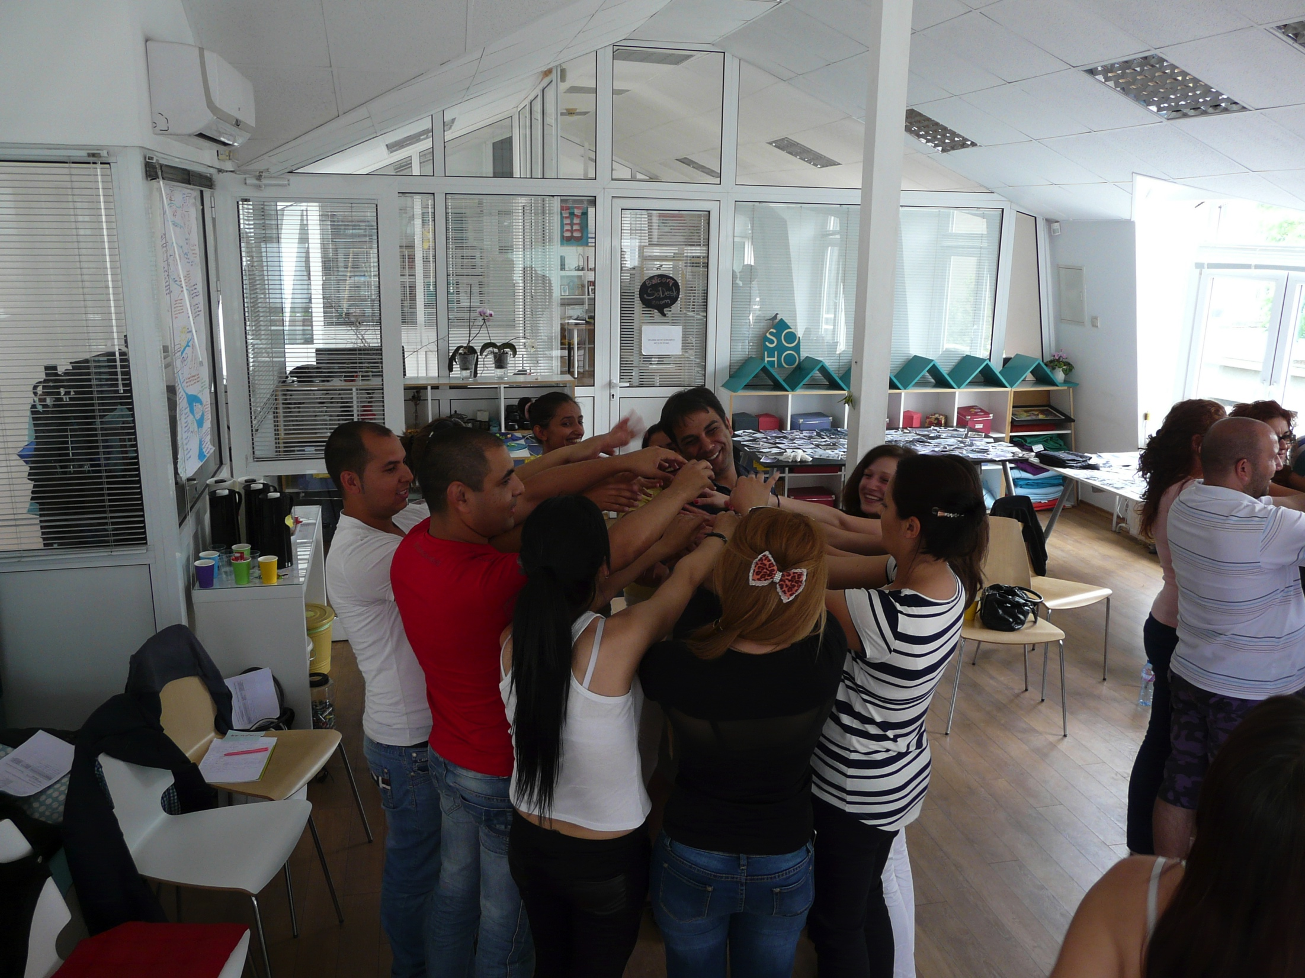

Slide 9
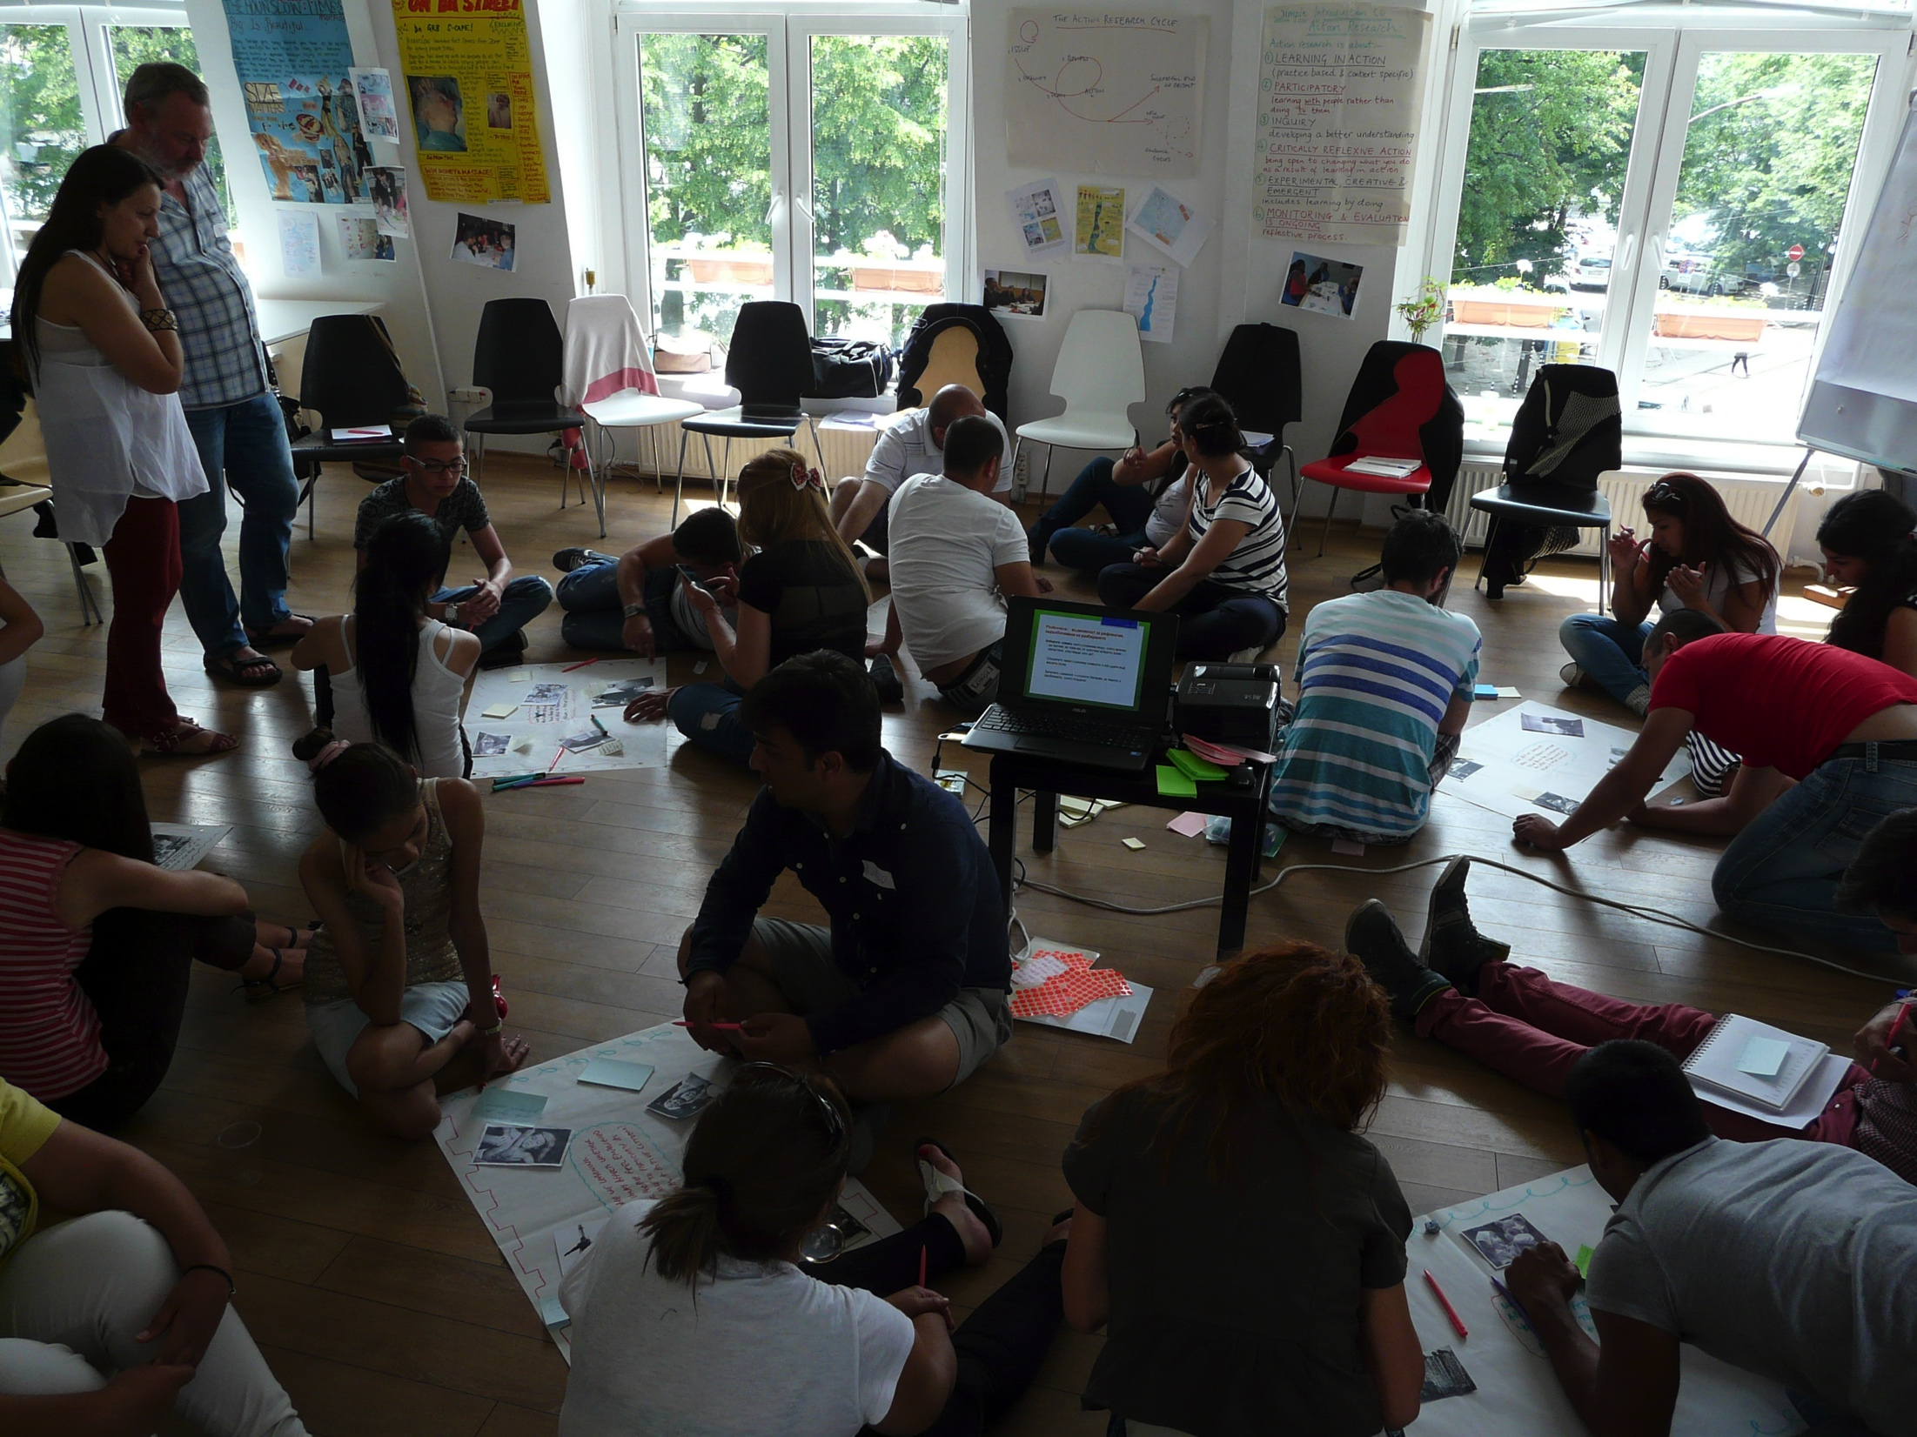

Slide 10
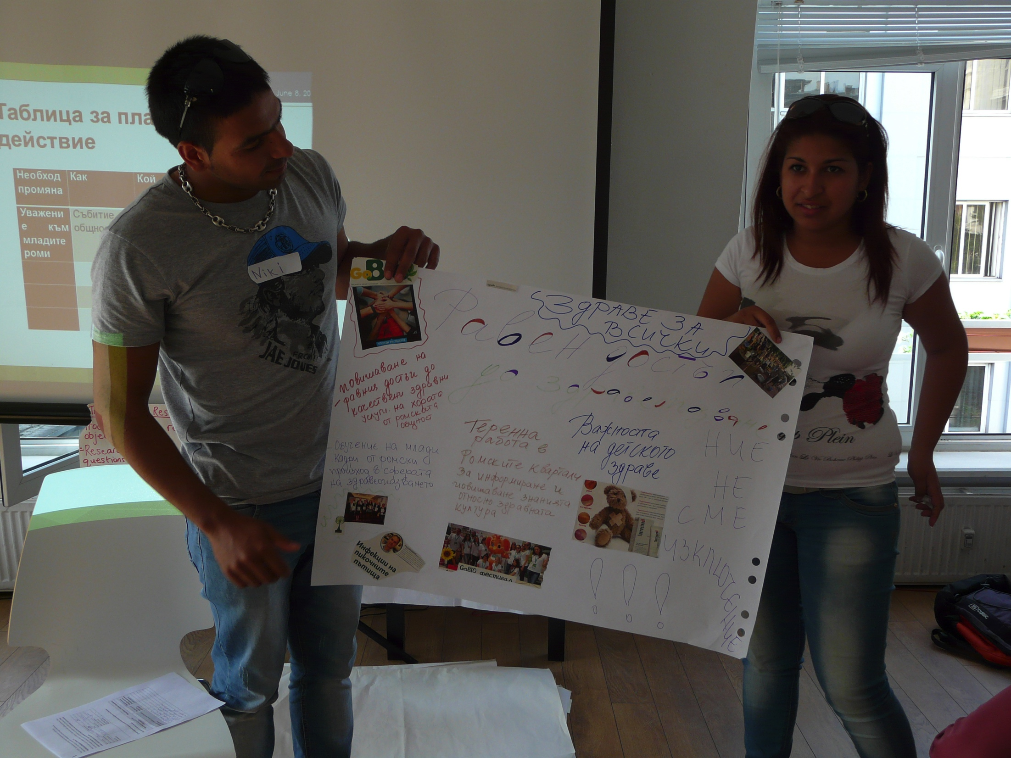
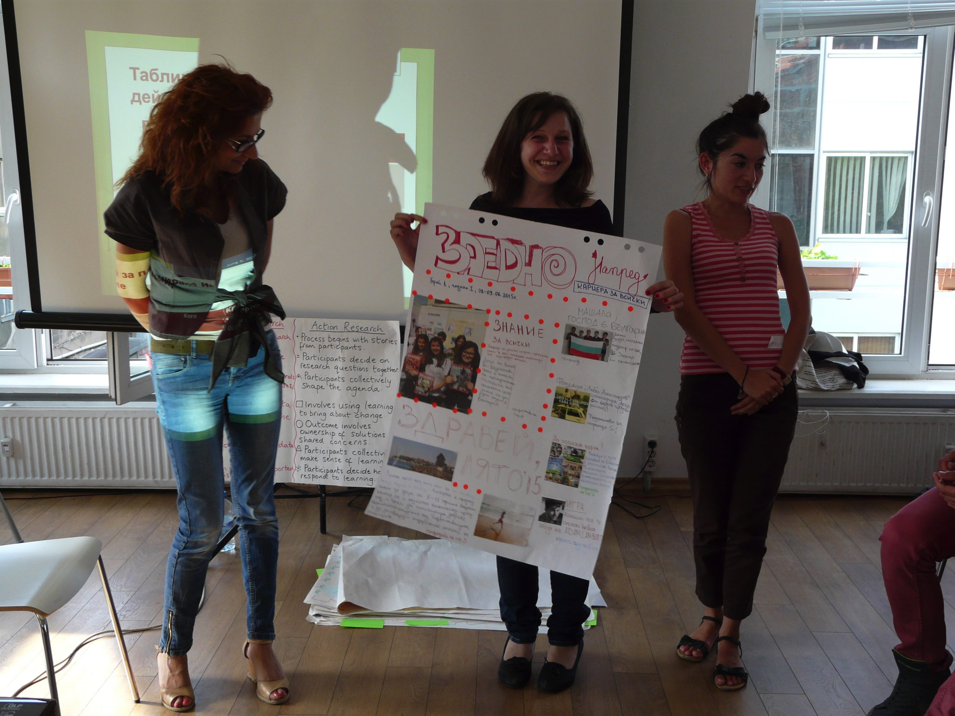

Slide 11
HOW WE/THEY UNDERSTAND PARTICIPATION:
activity; aim; cause; belonging to community; responsibility; shared responsibility; partnership; self-expression; inclusion in decision-making of young people; talking about youth participation, not Roma youth participation; taking initiatives and being supported in that; constant process of learning and sharing; initiating change; awareness; engagement; sharing responsibility; add value to different aspects of your life

Slide 12
Factors enabling participation
access to information for the young Roma; accessible language;
regular work on their motivation as with all young people;
individual approach to each particular group, non-stereotyping the group;
long-term investment and persistence;
continuity in working with young people, not only one-off initiatives or time-limited project activities;
work with the media, important to challenge stereotypes;
employ information technologies;
constantly explore alternatives, for example how Roma can be trained specifically to work in their own community;
being together with young people from other ethnicity and culture;
exploring and knowing each other;
being together with people from different generations - children and parents;
having in place policies that overcome segregation;
working to change prejudices;
good examples and role models - educated and successful Roma people;

Slide 13
mentorship;
suitable programs;
persistence in terms of time and process;
realizing the need of change;
willingness for sharing experience;
having motivation;
attitude for constant learning;
information on their rights;
peer-to-peer activities and learning;
inclusion in initiatives at an early age, possibilities for inclusion, having an aim;
shared responsibility with other participants;
social entrepreneurship;
having a cause, having an aim in their activities;
explain to the young people what is the meaning of participation, what are the consequences, what benefits might have in long-term perspective;
forms of participation adequate and close to the target groups.

Slide 14
Barriers
"When ideas are just a cliche";
People concerned about basic needs of their families, socio-economic status, poverty;
Lack of education, proper bringing-up, poor supportive environment in childhood;
Discrimination, isolation from society, marginalization, segregation
Self-discrimination - when the family does not allow even the thought for change and development and, as a consequence, young people develop a subjective sence and expectation that they will be discriminated whatever activity they undertake (like in the mechanism of a self-fulfilling profecy);
Lack of access to information;

Slide 15
Previous negative experiences associate dwith attemps for participation;
Political abuse of the vote of the Roma people in elections;
Incoherent, contradicting, conflicting ideas;
Lack of understanding on participation, not only in Roma community but in general;
Substituted values for commercial purposes;
Established leaders in the community who do not want to share power for a long time;
Intentional work against empowerment, keeping people in dependency;
Stereotyping and putting too much accent on differences between people and communities;
Prejudices;
Both sides do not allow differences;
Lack of standards for working with young people - how we create trust, how we address the specifics of their age and gender, how we motivate them;

Slide 16
Are we able to create culture where Roma young people are not put into the position of victims;
Generational barriers;
Organizational culture of the tems working with young Roma;
Lack of confidence in young people, faith and motivation for success;
Lack of engagement in the relevant adults with the problems of the young people;
Fear to show yourself - fear that you will be criticized, that the Roma community will start perceiving you as not "one of them", that the larger community will not fully accept you - fear of uncertainty if you would continue to be part of your community, if you will be able to handle the role of a "bridge" between your and the larger community;
Fear of failure;
Lack of facilities, physical environment and conditions, room, where participation activities can take place in the Roma communities in Bulgaria;

Slide 17
Language barrier for many Roma young people;
Lack of supportive family or community environment, lack of respect to the personal choice, culture promoting conformity;
Personal issues such as lack of motivation, apathy, constant consideration of the opinion of the other members of the community (the other side of conformity), perceiving participation as a too big challenge, not realizing a need of development and change, not enough desire to participate, not enough persistence;
Not enough good examples, there are some, but we need much more, and sometimes they hide their Roma origin;

